Slide 1



RESTful Web API Design with Node.js
Mark J. Buckler
OCPJP,CIWJS

Slide 2

Credits
Some of the contents of this slide presentation have been referenced and reproduced, from RESTful Web API Design with Node.js, by Saleh Hamadeh, ©2017 LinkedIn Corporation.
Additional content has been referenced and reproduced, from Understanding REST, by Michael Sullivan, ©2017 LinkedIn Corporation.

Slide 3
LEARNING OBJECTIVES
API Fundamentals
Communication via HTTP
REST Resources
Properties of RESTful APIs
Generating Twitter API Keys
Initializing MongoDB
Creating a Node.js / ExpressJS Application

Slide 4
API Fundamentals
What is an API?
Various definitions
A set of rules, protocols, and tools for building software applications
A tool, or set of programming instructions and standards for accessing Web-based software applications
An API is a set of functions, or a contract
Synopsis
An API is an interface that hides the details of an implementation

Slide 5
API Fundamentals
Use of APIs
Abstracting complex functionality
Performing tasks
Retrieving data
Manipulating data
Web services are APIs
A service offered by an electronic device to another electronic device
Communicating with each other via the World Wide Web

Slide 6

API Fundamentals
Use of APIs
Web API: an interface that runs on a network
There are two main specifications for used for implementing Web services
SOAP: Simple Object Access Protocol
REST: Representational State Transfer

Slide 7
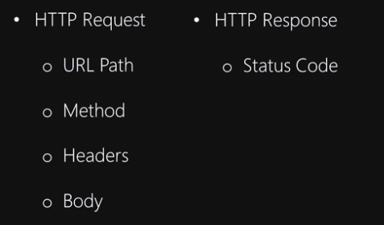
API Fundamentals
REST or RESTful APIs
Make use of various parts of the HTTP protocol

Slide 8
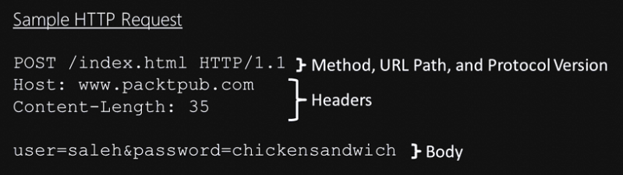
Communication via HTTP
HTTP Request
An HTTP request is the message that a client sends to an HTTP server

Slide 9
Communication via HTTP
URL Path
An identifier for a server resource
URL path to a static file http://www.pixabay/images/mypic.png
URL path to a server-side script or proxy https://www.mysite.com/signup.php
URL path to a social media profile https://www.linkedin.com/pub/mark- buckler/27/390/295

Slide 10
Communication via HTTP
HTTP Methods
An HTTP method is a verb that is used on a resource
GET: Used for retrieving data, should not include any sensitive information
POST: Used for submitting form data, or sending files to a server
PUT: Used for updating, or replacing files on a server
DELETE: Used for deleting files from a server
Usually GET and DELETE do not have a request body, POST and PUT usually do

Slide 11
Communication via HTTP
HTTP Headers
Key-value pairs that are sent with requests and responses
Examples
Host: tells the server the hostname that a user entered into the address bar www.google.com
Content-Length: Tells the receiver the size of the message body in bytes
Content-Type: tells the receiver the format of the data application/json

Slide 12
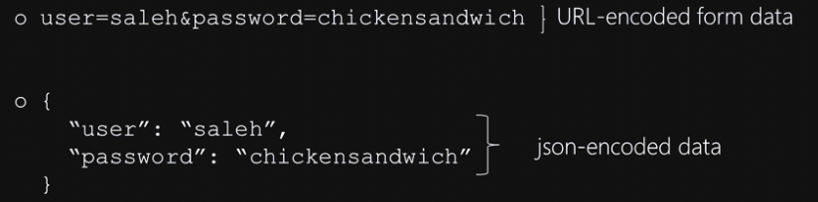
Communication via HTTP
HTTP Body
An HTTP body is the message’s actual data

Slide 13
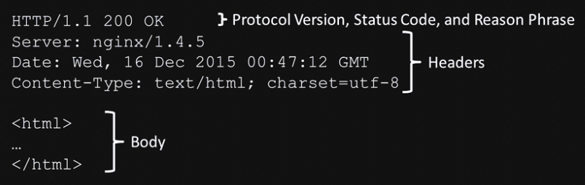
Communication via HTTP
HTTP Response
An HTTP response is the message that an HTTP server sends to a client in response to a request

Slide 14
Communication via HTTP
HTTP Status Code
An HTTP status code is a 3-digit number that shows the result of the request
The HTTP specification defines over 30 status codes
200s: indicate success
200 OK, used when a request was successful
300s: indicate redirection
301 Moved Permanently, resource moved elsewhere
400s: indicate a client error
404 Not found, a resource could not be found
500s: indicate server error
500 Internal Server Error, something went wrong

Slide 15

Communication via HTTP
Programming Exercise02_01_01 – Step 1
Examining HTTP Communications

Slide 16
REST Resources
REST Resources
RESTful APIs are most often used to perform the following tasks
Manipulate collections
Manipulate elements
Call remote procedures

Slide 17

REST Resources
Collection
A collection is a group of elements with the same representation
Examples: a list of events or messages
The interface to a collection has 2 parts
The endpoint of a collection is its HTTP URL path
The HTTP method by which it is accessed

Slide 18
REST Resources
Collection REST Interface
The endpoint of the collection, or HTTP URL, ends with the collection name /events or /messages
Collection endpoints support the 4 HTTP methods
GET: list the elements of the collection
POST: insert an element to the collection
PUT: replace the entire collection with another collection
DELETE: delete the entire collection

Slide 19
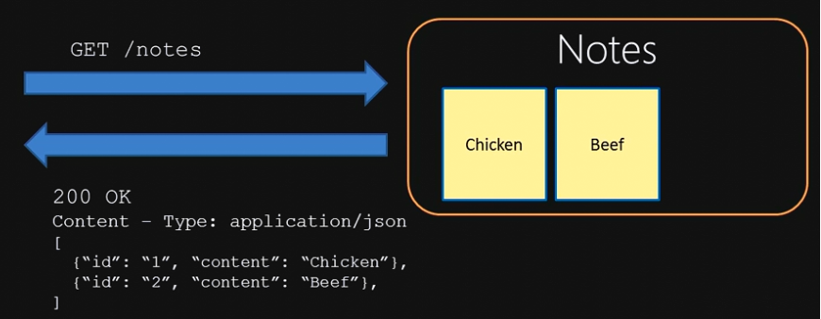
REST Resources
Collection REST Interface
GET a collection
Request
Response

Slide 20
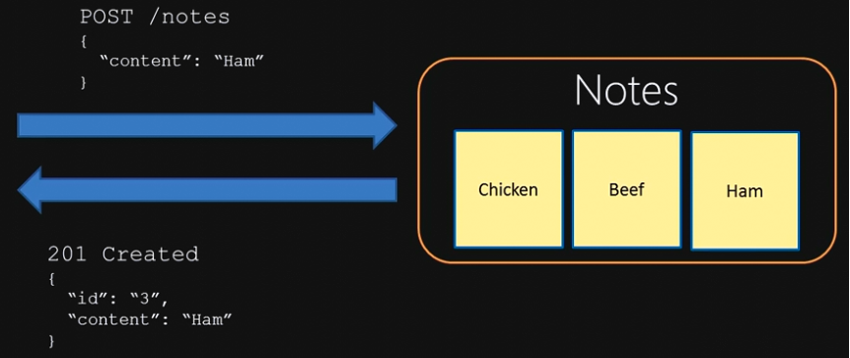
REST Resources
Collection REST Interface
POST to a collection
Request
Response

Slide 21
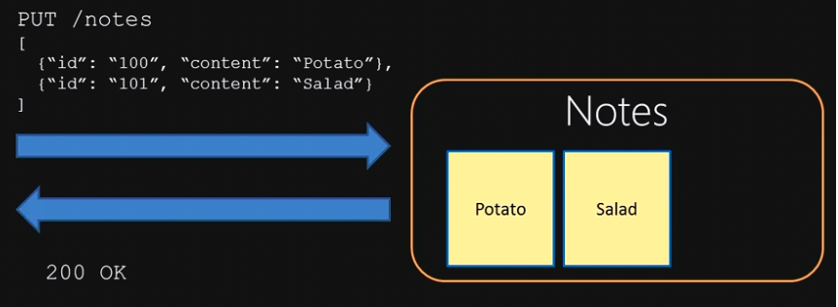
REST Resources
Collection REST Interface
PUT a collection
Request
Response

Slide 22
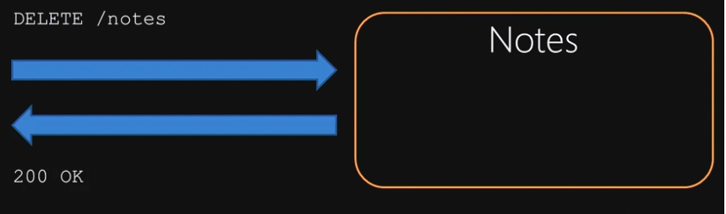
REST Resources
Collection REST Interface
DELETE a collection
Request
Response

Slide 23
REST Resources
Element REST Interface
An element in REST represents a single entity in a collection
The endpoint of the element, or HTTP URL, ends with the element ID /events/12345 or /messages/16
Element endpoints support only 3 HTTP methods
GET: retrieve the element
PUT: update the element
DELETE: remove the element from the collection
An element is inserted in a collection with a POST to the collection, not to an element

Slide 24
REST Resources
Remote Procedure REST Interface
The endpoints of remote procedures do not have a standard naming convention
Best Practices
Use verbs that describe the procedure being executed /search or /reply
Use GET for calling safe procedures
Use PUT, POST, and DELETE for calling unsafe procedures
Safe procedures have no side effects, calling it any number of times does not change response or server state

Slide 25
REST Resources
Programming Exercise02_01_01 – Step 2
Obtain a Twitter Account

Slide 26
Properties of RESTful APIs
What is REST?
Representational State Transfer
An architecture for designing network-based applications
Things that REST is not
Protocol
Framework
Standard

Slide 27
Properties of RESTful APIs
Architectural Constraints
Client-server
Stateless
Caching
Uniform Interface
Layered System
Code on demand (optional)

Slide 28

Properties of RESTful APIs
Client-server
REST uses a client-server architecture to separate concerns
Client handles the UI
Server handles the data storage

Slide 29
Properties of RESTful APIs
Stateless
REST servers are stateless
Server knows nothing about the client except what is contained in the client request
Each client request must contain all the information necessary to understand the request
Session state is therefore kept entirely on the client
Benefits
Visibility - developers don’t need to look farther than the request to trace a bug
Reliability - easy to recover from system failures
Scalability – servers can immediately free up resources

Slide 30
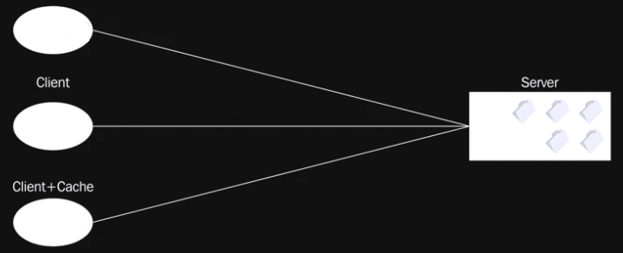
Properties of RESTful APIs
Caching
All REST responses must be labeled as cacheable or not

Slide 31
Properties of RESTful APIs
Caching Benefits
Performance
Reduces server wait time and load
Stateless + Caching = Cache Anywhere
Many request don’t need to go all the way to the server
Scalability
Server gets fewer requests, so can handle more clients
Caching Negatives
Data reliability, data can get stale
Must find correct balance

Slide 32
Properties of RESTful APIs
Uniform Interface
Identification of resources
All resources accessed through endpoints
Manipulation of resources through representations
Do not need to mimic server implementation, use a standard representation like JSON or XML
Self-descriptive messages
Server includes to help client process, such as Content-Type headers
HATEOAS - Hypermedia as the Engine of App State
Clients know only a fixed endpoint
This endpoint gives access to others only by hyperlink

Slide 33
Properties of RESTful APIs
Layered System
Intermediary components can transform the content of messages
Enables encapsulation
Layers can be added in front of a final layer
Layer acts as a middleman
Enables scalability
Layers can implement load balancing
Enables security
Layers can add access control rules to data crossing a boundary, provide a firewall

Slide 34
REST Resources
Programming Exercise02_01_01 – Step 3
Create a Twitter App and Initialize MongoDB

Slide 35
REST Resources
Programming Exercise02_01_01 – Step 4
Creating a Node.js / ExpressJS Application

